Slide 1
WELCOME
KnobbsSpringsBaptist@gmail.com
(512) 273-2743
www.KnobbsSpringsBC.com
WE ARE GLAD YOU ARE HERE!
Please Contact us if you need any information posted in the morning announcement slides!!

Slide 2
OPERATION GLORY SDG Soli Deo Gloria “To the Glory of God Alone”

Slide 3
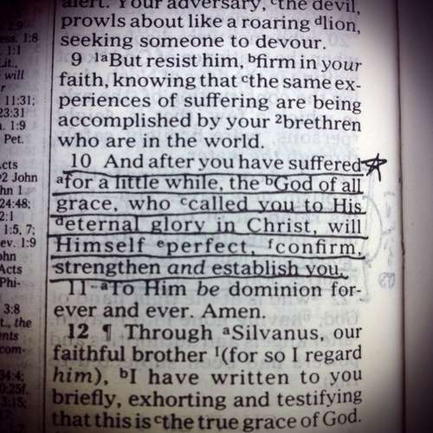

Slide 4
EVENING WORSHIP SERVICES
6:00 p.m.

Slide 5
NURSERY
AVAILABLE!
Ages Birth to Kindergarten
Please find an usher for assistance

Slide 6
Upcoming Events – October
10 Senior Adult Fellowship
13 Business Meeting
20 Annual Association Meeting
24 Senior Adult Fellowship
27 High Attendance Sunday
27 Amanda Turnipseed Benefit & Lunch

Slide 7
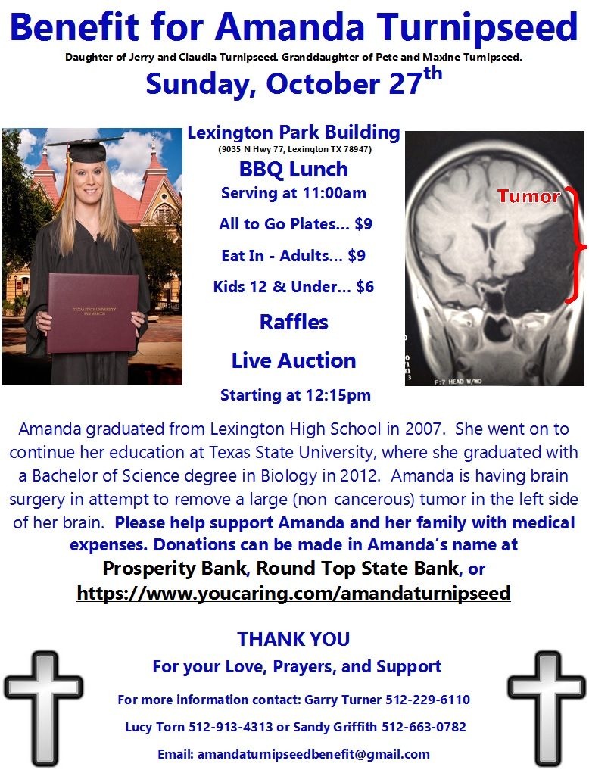

Slide 8
SENIOR ADULT FELLOWSHIP 10:00 am
Upcoming Dates
October 10th & 24th
WHAT: A time of Fun, Food, & Fellowship. We meet for fellowship & games, & then eat a DELICIOUS covered dish meal at noon!
WHEN: The 2nd & 4th Thursday of every month!

